Slide 1
Peg Test
Initial setup
(Fig. 1)
Level height
A
< 10 feet
< 100 feet
< 10 feet
Peg A
Peg B
Peg C
Peg D

Slide 2
(Fig. 2a)
Level Rod
Shoot near elevation (C to D) at level height A.
Level height
A
< 10 feet
< 100 feet
< 10 feet
Peg A
Peg B
Peg-C
Peg D
(Fig. 2b)
Move level rod to Peg A. Swing level 180 degrees. Shoot far elevation (C to A) at level height A. Do not move level rod from
Peg A.
Level Rod
Level height
A
< 10 feet
< 100 feet
< 10 feet
Peg A
Peg B
Peg-C
Peg D

Slide 3
(Fig. 3a)
Move level to Peg B and increase the elevation of the level to Level height B. Shoot near elevation (B to A).
Level Rod
Level height
B
< 10 feet
< 100 feet
< 10 feet
Peg A
Peg B
Peg C
Peg D
(Fig. 3b)
Swing level 180 degrees. Shoot far elevation (B to D) at level height B.
Level Rod
Level height
B
< 10 feet
< 100 feet
< 10 feet
Peg A
Peg B
Peg C
Peg D

Slide 4
(Fig. 3a)
Level Rod
Level height
B
< 100 feet
< 10 feet
P1
P2
P3
(Fig. 3b)
Level Rod
Level height
B
< 100 feet
< 10 feet
P1
P2
P3

Slide 5
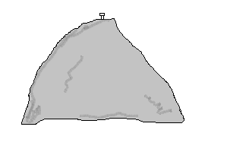
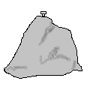
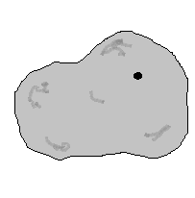
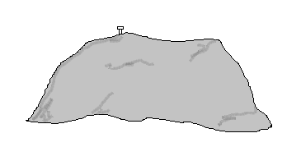

Slide 6
< 10 feet
< 100 feet
P1
P2
P3
P1
P1
P1
< 100 feet
< 10 feet
P1
P2
P3

Slide 9
< 10 feet
< 100 feet
P1
P2
P3
P1
P1
P1
< 100 feet
< 10 feet
P1
P2
P3

Slide 10
Level height
B
< 100 feet
< 10 feet
P1
P2
P3

